Slide 1

Admin in a day: Managing Power Apps and Power Automate in the enterprise
Manuela Pichler
Senior Program Manager, Power CAT

Slide 2
Framing Today
Secure
Monitor
Alert & Action
Deploy
9:00 - 10:15
10:30 - 12:15
Lunch
1:15 – 2:30
2:30 – 4:15
Presentation (45)
Hands on Lab (30)
Questions + Break (15)
Presentation (30)
Hands on Lab (45)
CoE Starter Kit Demo (30)
Questions + Lunch (60)
Presentation (30)
Hands on Lab (45)
Questions
Presentation (15)
Hands on Lab (75)
Questions + Break (15)

Slide 3
Framing Today
Module 1: Secure
Understand the basics of security & administration
Module 2: Monitor
Reporting and telemetry
Module 3: Alert & Action
Action through Automation
Module 4: Deploy
Application Lifecycle Management & Automated Dev Ops

Slide 4
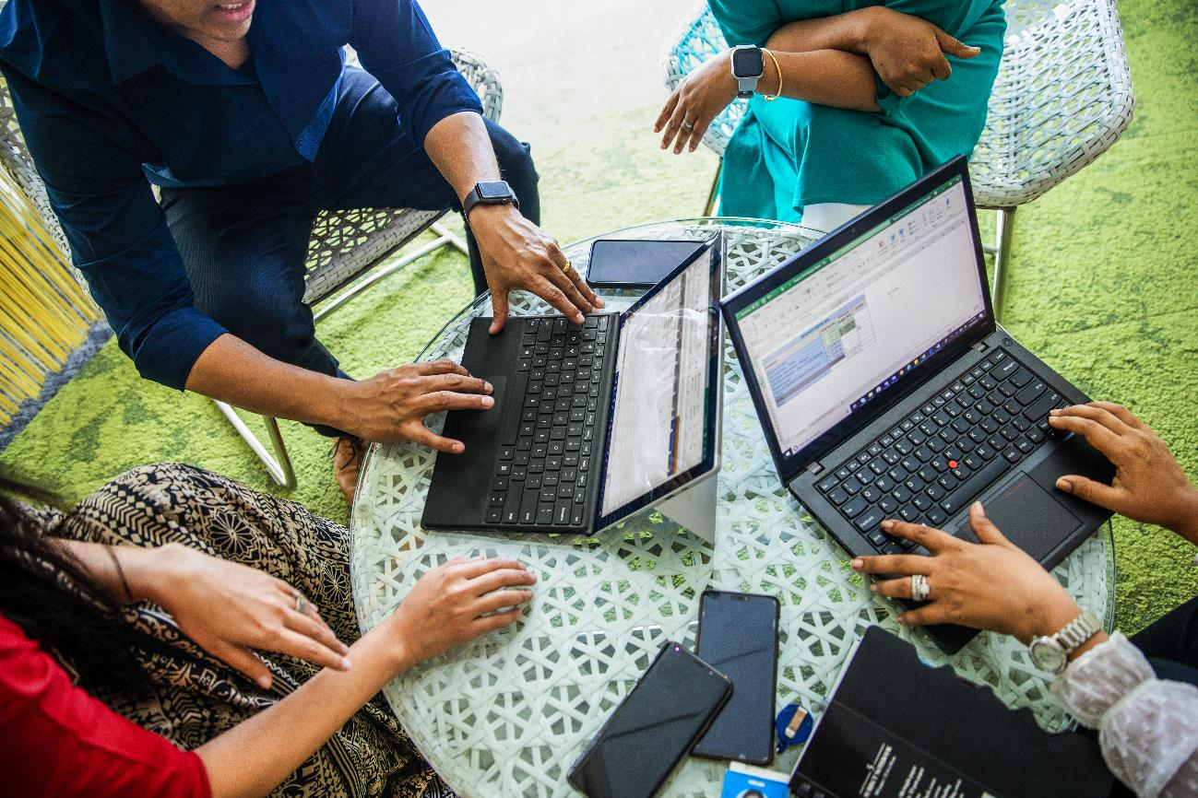
Module 1: Secure

Slide 5
Hands on Lab Module 1 - Secure
Lab Pack Download: aka.ms/PowerApps/AdminInADay
Objective
Overview of admin tools by exploring our preconfigured lab tenant
Understanding DLP policies
Understanding solutions and security roles
Notes
Do Not provision a CDS for Apps database in the Personal Productivity (Default) Environment
Your lab account is an Environment Admin. It does not have Global Admin privileges.
Getting started
In an In-Private browsing session, go to https://admin.powerapps.com
Login with the Lab Admin credentials on your desk

Slide 6

Module 2: Monitor

Slide 7
Hands on Lab 2 – Monitoring
Objective
Explore CoE Starter Kit
Learn how to enable and make use of monitoring tools, OOB and custom made
Power Apps app to monitor activity
Power Automate to notify admins of activity
Review Office 365 Activity Logging
Notes
Audit logging has already been enabled by global tenant admin in the lab tenant
Getting started
In an In-Private browsing session, go to https://make.powerapps.com
Make sure to be logged in with your Lab Admin credentials
Go to your Central Apps Test – user# environment

Slide 8

Module 3: Alert & Act

Slide 9
Hands on Lab 3 – Action through Automation
Objective
Automate Environment request and creation with a Flow + Microsoft Forms
Nurture users to help adopt the Power Platform using Power Automate to welcomes new makers
Notes
In the flow, Environment location needs to be lower case (e.g., ‘unitedstates’).
Database creation: 1033 == English language
Getting started
In an In-Private browsing session, go to https://forms.microsoft.com
Make sure to be logged in with your Lab Admin credentials

Slide 10
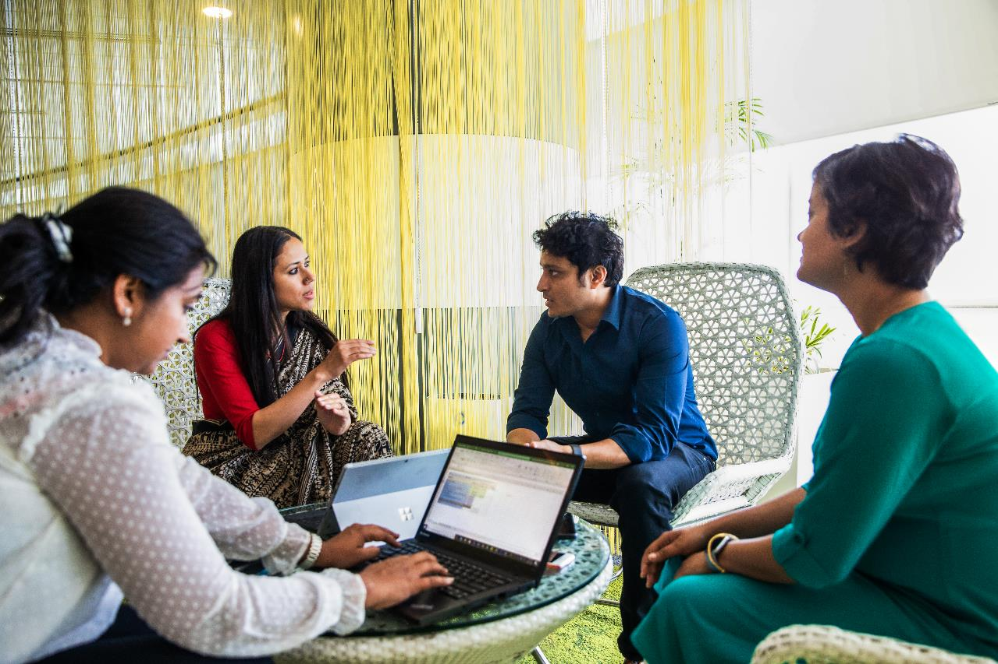
Module 4: Deploy

Slide 11
Hands on Lab 4 – Deploying apps
Objective
Configure Azure DevOps Build Tools to deploy a solution
Deploy the Device Ordering Development team’s solution into Test
Notes
Download Managed solution for deploying to test, Unmanaged for keeping an editable copy of the solution. This is good practice to follow.
In Exercise 3, start portal in preview mode by going to https://make.preview.powerapps.com
Getting started
In an In-Private browsing session, go to https://make.powerapps.com
Make sure to be logged in with your Lab Admin credentials
Go to the Device Ordering Development environment and export the Contoso Device Order Management solution

Slide 12
Call to action - Resources
Download a collection of components and tools to help you get started aka.ms/CoEStarterKit​
Find training resources, including guided learning and step-by-step guides aka.ms/PowerPlatformLabs​
Read up on customer success stories and find resources relevant to your experience, technical background and skill level aka.ms/PowerPlatformResources​
Get started with the Microsoft Power Platform path on Microsoft Learn, a free online and interactive training platform https://aka.ms/PowerUp​

